Slide 1
Occupational Specialist Component Content: Digital Production, Design and Development
The T Level T Level Technical Qualification in Digital: Digital Production, Design and Development includes a single Occupational Specialist Component. Therefore, there is a single synoptic assessment for the Occupational Specialist Component, which is an extended ‘design, development and implementation’ project. The synoptic element of the project is important in order to ensure that students are able to demonstrate threshold competence: this is the principal reason why the Occupational Specialism is assessed via a single extended project assessment to ensure that students are able to evidence all the skills required by the Performance Outcomes.
The T Level Technical Qualification in Digital: Digital Production, Design and Development Occupational Specialist Component consists of several activities grouped into four substantive tasks.
Each task will be completed during a window set by Pearson during which you will schedule supervised assessment sessions. In some cases, tasks will also involve opportunities for unsupervised activities where the requirements of the skills being assessed make this necessary.

Slide 2
The unit outcomes
1.5 Investigate the current and potential uses of emerging technologies and how they impact on industries
Investigate impact on software development of emerging technologies such as:
operational technology (OT)
artificial Intelligence (AI) and Virtual Intelligence (VI)
conversational AI
the Internet of Things (IoT)
machine Learning
object recognition
biometrics
computer vision
robotics
cloud services and platforms
blockchain
data lakes and data warehousing
drones
3D printing
5G networks

Slide 3
Learning Objectives
Aims:
To investigate how an organization uses technology to meet its needs
Objectives:
To be able to define how an organization uses technology to meet its needs.

Slide 4

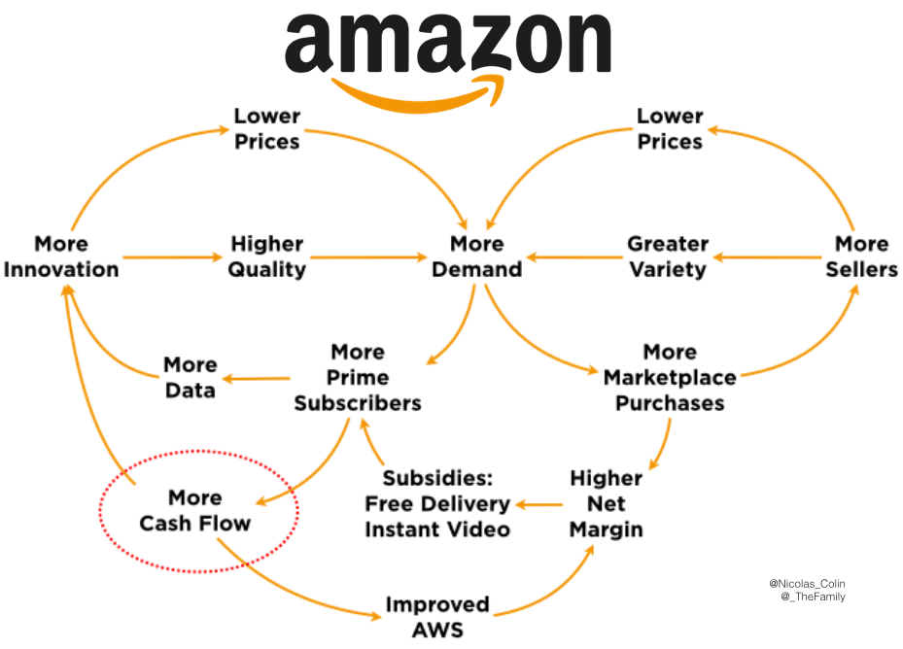
Why organisations invest in technology
Because investing in technology can be expensive, organisations must be able to justify the choices they make as they might have to explain them to their STAKEHOLDERS (individuals or organisations who have an interest or a stake in something - this is particularly true of investors).
The following are some of the main reasons why an organisation will invest in technology to meet its needs:
Improving productivity
Meeting business goals
Improving efficiency
Increasing cost effectiveness
Achieving increased growth
Innovating
Improving agility and competitiveness
Global communication
Increassing promotion and sales
Having a wider consumer reach
Notes:
https://blog.grabcad.com/blog/2019/02/05/4-reasons-why-companies-need-to-be-investing-in-tech-in-2019/
https://www.aboutamazon.co.uk/innovation/technology-at-work
https://www.fastcompany.com/3067455/why-amazon-is-the-worlds-most-innovative-company-of-2017
https://www.cnbc.com/2019/10/24/amazon-q3-earnings-preview.html
https://www.cnbc.com/2020/03/24/amazon-been-best-bet-among-tech-giants-during-pandemic-induced-selloff.html
https://salon.thefamily.co/11-notes-on-amazon-part-1-cf49d610f195
https://www.aboutamazon.com/amazon-fulfillment/our-innovation/what-robots-do-and-dont-do-at-amazon-fulfillment-centers/
https://www.greyb.com/amazon-business-strategy/
https://www.cnbc.com/2019/10/19/microsoft-amazon-google-and-facebook-have-new-gadgets-for-holidays.html
https://www.geekwire.com/2019/robots-drones-satellites-amazons-vision-future-automation-humanity/

Slide 5


Improving productivity
There are many ways that technology can improve productivity. Here are a few examples.
Collaborative working: where a group of staff work together on the same document, graphic, or idea, in real time.
Using interoffice communication tools: this can speed up the process of getting answers to questions (rather than the questions sitting in an email trail).
Connecting remotely: this means having an ability to quickly organise virtual meetings so that decisions can be made. All relevant people could be included regardless of their actual location. This can save time.
Being organised: ensuring that files are managed and sorted into appropriate directories will save time finding important files.
Financial tracking: access to a wider range of faster and more accurate financial data and information will speed up decision making.
Notes:
https://www.fluxmagazine.com/technology-increase-productivity-in-manufacturing/

Slide 6
Meeting business goals
Most organisations understand the importance of linking their business strategy with their IT strategy.
Meeting some of these goals might be achieved using technology- for other goals this may not be the case.
The table gives some examples for you to consider.

Slide 7
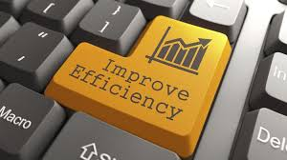
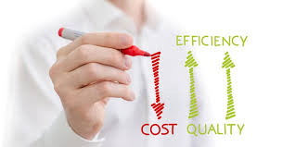
Improving efficiency
Using technology to capture, examine and analyse the organisation's processes will help the business understand where it is inefficient, for example, using data about IT failures and time taken to resolve the issues can prove that existing hardware has become unreliable and outdated.
Many organisations are now using on line frunctionality to improve staff training. Training sessions could focus on a range of topics such as customer service, health and safety, manual handling, Control of Substances Hazardous to Health (COSHH) Regulations 2002, export and international trade, analysing data, or cybersecurity.
The advantage of using on line tools for staff training is that training sessions can sometimes be undertaken over a period of time, when the employee has less to do. Also, if you are using technology, you can track employee training performance and completion, identifying any areas where more work is needed.

Slide 8
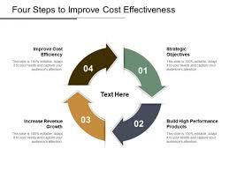
Increasing cost effectiveness
Organizations can use data and statistical analysis techniques on a range of factors to calculate the return on investment (ROI).
This is a recognized calculation, and it looks like this:
Net profit
Return on investment = ------------
Total amount of the investment
If the answer to the calculation is Zero or is a negative value, it means the amount of extra profit that will be generated by the investment will not be cost effective.

Slide 9
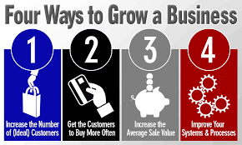
Achieving increased growth
Digital marketing is one of the most important strategies for increased growth and the two key technologies for use in this area are social media and blogs/vlogs.
As mentioned earlier in the unit (A2 'Use of social media'), bloggers and vloggers can have a real impact on the sales of products and services.

Slide 10

Innovating
Collaboration is one of the key ways that organisations innovate.
This is because sharing ideas often produces new ideas.
Most organisations make use of multi-user software, collaboration software and real-time communication tools to manage creative processes, as shown in the table

Slide 11
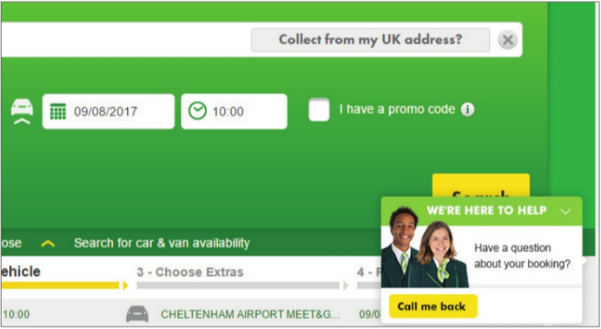
Improving agility and competitiveness
Developing designs faster through collaboration and using CAD/CAM systems to get designs into production faster is just one example of how organisations can improve their agility.
Getting products and services to market faster will improve competitiveness.
Providing quick and easily accessible customer support is another example.
Many businesses use technology to provide an additional level of more accessible service to make their products and services more attractive to potential customers.

Slide 12

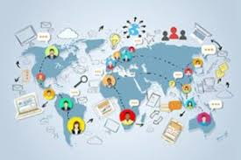
Global communication
One of the key benefits of today's fast, reliable communications technology is that it has become much easier to trade with the whole world.
Many people believe that the negative impact of trading across time zones has been dramatically reduced through investment in new technologies, even in the simplest of ways, for example the use of mobile phones and apps.
With more than 95 per cent of organisations thought to have an online presence, customers can access them and their services 24 hours a day, 7 days a week.

Slide 13

Increasing promotion and sales
With an online presence, businesses are much more able to be responsive to what their customers want. They can also respond quickly to the
activities of their competitors (for example, offering discounts if a major competitor is doing the same).
There seems to be some consensus in the business community that the amount of discount offered directly affects the amount of additional sales. Strategies to increase sales include:
offering deals (such as buy one, get one free)
sending out targeted e-vouchers by email to generate interest
offering deals which involve free shipping.
However, offering deals and discounts does reduce the profitability of a product or service, so most organisations do not use discounting as a long-term strategy.

Slide 14


Having a wider consumer reach
Investing in new technologies helps organisations to access a wider and more varied range of markets using the internet.
Customers can place electronic orders at any time of the day or night, reducing the need for expensive phone calls and saving them time.
However, there are consequences of trading with the wider world, for example other countries may have different laws about particular products or services that must be taken into account.
There may be a situation in which you are not allowed to make a product available in a country or region.

Slide 15
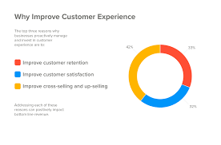
Providing instant customer service
We have so far concentrated on how technology can improve access to customers, how customers can get faster support and how technology can be used to grow business.
One additional way that technology can impact on the relationship between organisations and their customers is in the management of complaints.
Realistically, no organisation can claim to be completely complaint free, but some organisations take pride in their use of the internet and social media for managing complaints.
You should realise, however, that not al I complaints will be managed in the public domain (where they are visible to everyone).
Some complaints have to be taken offline (even if they started online). Remember to go back online once the problem has been resolved and be positive about the outcome.
It is also worth keeping in mind that badly written responses to customer complaints can do as much damage as not responding to the complaint at all.

Slide 16
How organisations select technology
Which technologies organisations choose to use will depend, to a large extent, on the product or service and the profile of their customers or clients.
The table gives some examples of the ways in which organisations use technologies and why they use them.
Consideration | Examples
Type of business | If the business is selling a product or service that has nothing to do with technology (for example, garden tools such as rakes. spades and hedge trimmers). it might only need the most basic support such as a website about their products with a range of FAQS (frequently asked questions are a predicted list of common questions that users are likely to ask). If the business is selling a technology-related productor service, it will probably choose to use a wide range of technologies, including websites, blogs and/or vlogs, social media, online interactive customer support. The content is likely to be extensive and complex.
Needs of customers | There may be some products or services for which customers will need little or no support other than a telephone number or an email address. This is often the case with old products that are no tonger sold but which consumers might still own. Most organisations will keep information about old or outdated products, but they might not have this information aniline all the time, so if they need it, customers will have to request it. Organisations will also consider the profile of their customers, for example if the product is targeted at a particular type of user, then it would make sense to use the technologies that this type of customer wilt use.
Hardware/ software and networking requirements | Organisations have to be very careful as they will need to calculate the return on investment in comparison to the amount of money they are potentially going to spend. Cloud technology has made many things possible and organisations will consider what cloud services could offer in their deliberations.
Particular security issues | Organisations must never forget their responsibilities in relation to security, whether this is the security of their own systems, or the security of customer information(as captured by their technologies).
Each consideration must be carefully investigated and informed decisions made.
Getting it wrong can have a negative impact on the organisation and its reputation or brand, as well as its finances.

Slide 17
How organisations make decisions
There are three common triggers that drive organisations to think about changing their use or application of technology.
A problem occurs or an opportunity arises: this is usually something that they have to react to, such as identifying that the business is running out of storage or that market research has identified a new business opportunity.
Actions need to be taken because of business strategy or an organisational policy: for example, needing a new website in a particular language because the organisation is seeking to trade in a new country, or fulfilling the organisation's policy to upgrade all mobile devices every three years.
Feedback from stakeholders: customers may have identified issues with the website (such as broken links or outdated content), or employees may complain that the DATABASE has become unresponsive so that it takes a long time to edit a record (this could be because the database contains a lot of old records which are slowing it down).

Slide 18
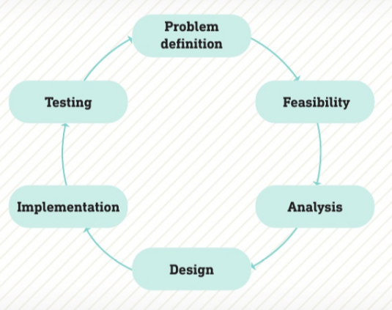
Feasibility study
Life cycle models are used to manage developments and projects there should be activity in every phase, although some methodologies place more importance on some parts of the life cycle than others
Whichever trigger causes the organisation to investigate its IT systems, the process it will go through follows the standard development life cycle shown in the diagram.
Once the problem or opportunity has been identified and defined, a feasibility study is carried out.
The study investigates the problem or opportunity thoroughly to establish whether something needs to be done or not. If so, then the process moves to the next stage (analysis).
If not, the problem might need to be redefined or the opportunity re-examined before the organisation decides that no action is necessary.

Slide 19
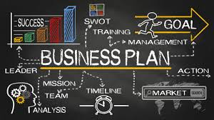

Digital strategy, policy or business plan
Organisations have to plan for the future.
As part of this plan, they have to think carefully about what they want to do in the short term (six months to two years), medium term (three to five years) and the longer term (five to ten years).
Organisations that do not think about the future will often fail because they are not planning resources, finance and technology that will help them meet their future goals.
They become reactive (responding when something happens instead of thinking ahead) rather than proactive (making informed decisions, planning what will happen and then taking appropriate action).

Slide 20
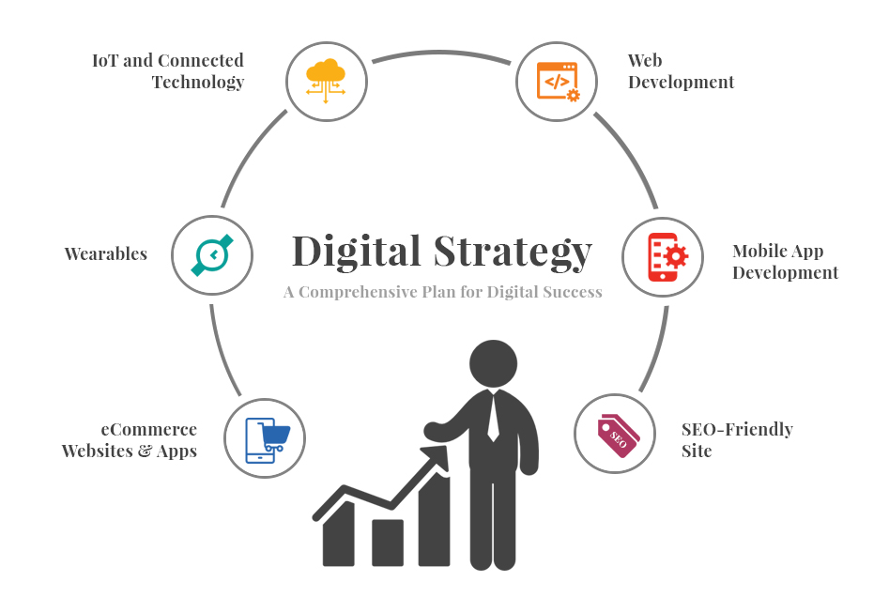
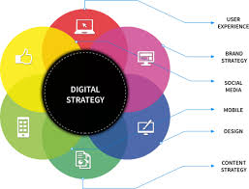
Digital strategy, policy or business plan
One of the more recent and controversial digital strategies has been to allow staff to bring their own devices to work and allow them to connect to the organisation's own Wi-Fi.
The BRING YOUR OWN DEVICE (BYOD) strategy has allowed some organisations to reduce the costs of the technology by making use of staff members' own devices.
An additional benefit has been the improvement in staff morale.
Some organisations are also thinking carefully about their email policies because there is a consensus that emails are often unnecessary and time wasting.
Whole groups of people are copied into emails 'for information only’.
These do not require any action but do take time to read.
For this reason, some organisations ban this practice and insist that emails are only sent to other members of staff when action is required.

Slide 21
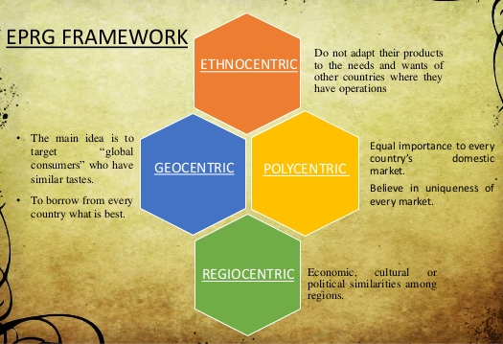
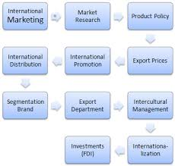
Digital strategy, policy or business plan
Digital strategies, policies and business plans should be reviewed regularly.
It is not sensible to create a strategy or plan and then stick to it without reviewing it.
That means revisiting it regularly. For example, an organisation might be planning to start trading in a country that then suffers a natural disaster, such as the floods in Malawi and Mozambique in 2015 or Hurricane Katrina in 2005.
Similarly, wars and civil unrest in countries such as Syria, Iraq, Yemen, Libya, Afghanistan and Turkey in recent years would impact on business plans in the same way as a natural disaster.
Organisations need to think about their business in a much bigger context and change their plans if necessary.

Slide 22
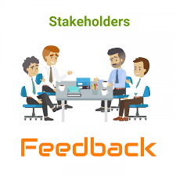
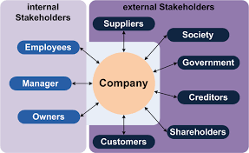
Feedback from stakeholders
Organisations must continuously listen to their stakeholders because both customers and employees can identify problems early, which should mean that they can be dealt with before they become much bigger problems.
Notes:
https://www.geekwire.com/2018/amazon-is-searching-for-the-fourth-pillar-of-its-business-and-jeff-bezos-sees-at-least-three-possibilities/

Slide 23
How organisations assess if technology has met their needs
Organisations must always be able to justify the expenditure on technology by showing how they have benefited from this activity.
Benefits
In order to establish whether an organisation's use of technology has met its needs, it will need to evaluate the impact that the technology has had on its activities.
This will, in part, be achieved through statistics, but should also involve talking to the people who have been affected by the changes and improvements made.
Some of the benefits, and how to measure them, are shown in the table.
Even if the system is working better, the organisation should keep asking: 'Is there anything else that could provide additional benefits?'

Slide 24
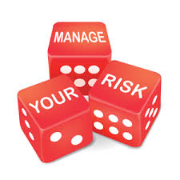
Risks and issues
When implementing new technology there are risks and issues you should be aware of.
Change management
Ethical considerations
Data management
Legal considerations

Slide 25
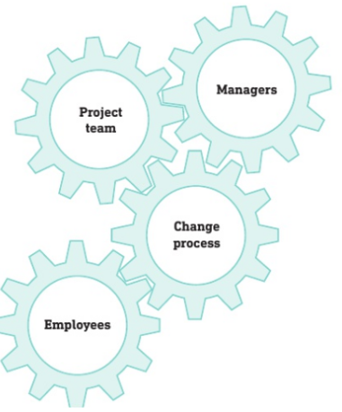
Change management
Implementing change requires different parts of the organization to work together.
Usually, managers and project members trigger the change process, which is then filtered through to the employees.
But change also carries risks and potential problems.
But change also carries risks and potential problems.
Staff may need to be trained to use the new systems -this can be expensive and while they are training, they will not be doing their usual job.
Even with training it can take time for staff to become confident with new technology.
Old systems need to be turned off as the new systems are turned on-this is often done overnight to cause the least disruption to the service.
There is always a risk that data could be lost when moving activity from one system to another.

Slide 26


Ethical considerations
Before changing systems or technologies, the organisation should undertake a consultation with the stakeholders. This will ensure that they feel part of the process and that they are involved in the process of change, rather than change just happening and them having to cope with it. Organisations that do this are much more successful in implementing change.
Change can cause stress, so organisations should make sure that employees are fully aware of how the change will affect them. For example, they might need to work different !hours or even relocate (move to another department or even another town or city). If they have dependents, this might mean an additional level of understanding from the organisation while the transition takes place.
Data management

Slide 27
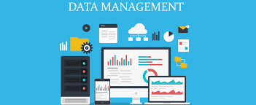
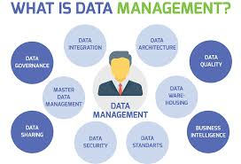
Data management
Changing technology is also a time when the ownership of data should be revisited.
Data needs to be secure and kept private and organisations must make sure that changes they make to their systems do not compromise this.

Slide 28

Legal considerations
There are rules and regulations that govern how data is stored and used, so any changes in the use of the data need to be checked for COMPLIANCE (working within the legal requirements) with these regulations.
The key pieces of legislation that affect data and systems are the:
Data Protection Act 1998
Computer Misuse Act 1990.

Slide 29
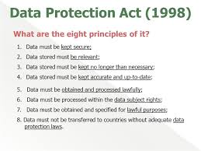
Data Protection Act 1998
The Data Protection Act is designed to protect data by setting out how it can be used and how it must be stored.
There are rules that must be followed by organisations and there are penalties for organisations that do not comply with the law.
Organisations that want to store data about [People have to apply for permission to do so from the Information Commissioner's Office.
They are then given a checklist of actions that they must take and evidence they must generate to prove that they can comply with the regulations.
The application is then approved or declined.
If an organisation is declined, it can prevent them from working with other organisations.

Slide 30



Computer Misuse Act 1990.
The Computer Misuse Act is designed to protect data and materials from criminal activity.
This applies to individuials as much as it does to organisations, as in the following examples.
HACKERS: unauthorised people who use network functionality to gain access to systems with the intention of stealing or destroying data or disrupting the operation of the system.
Theft: did you know that you are committing a criminal offence ifyou upload and share copyright materials on the internet? COPYRIGHT means that the person who created the material is the only person who can assign other people the right to use it. This is why copying music or videos and giving them to your friends without the permission of the copyright holder is against the law.
Pornography: in addition to copyright issues and other legal restrictions on pornography, and due to the rise in 'revenge porn', it is now illegal to share photographic images or videoed content of individuals without their consent and if you intend to cause them distress.
Identity theft: this is using someone's personal information to create false profiles or to pretend to be that person for criminal purposes (such as acquiring loans or credit cards in someone else's name).

Slide 31
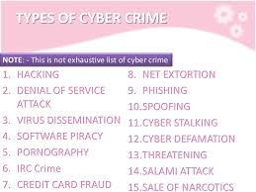
Computer Misuse Act 1990.
There are three key offences under the Computer Misuse Act.
Accessing someone's files without their permission.
Accessing their files with a view to committing other crimes.
Changing data without permission (this includes writing VIRUSES to destroy data).
Notes:
https://www.voipshield.com/the-16-most-common-types-of-cybercrime-acts/

Slide 32
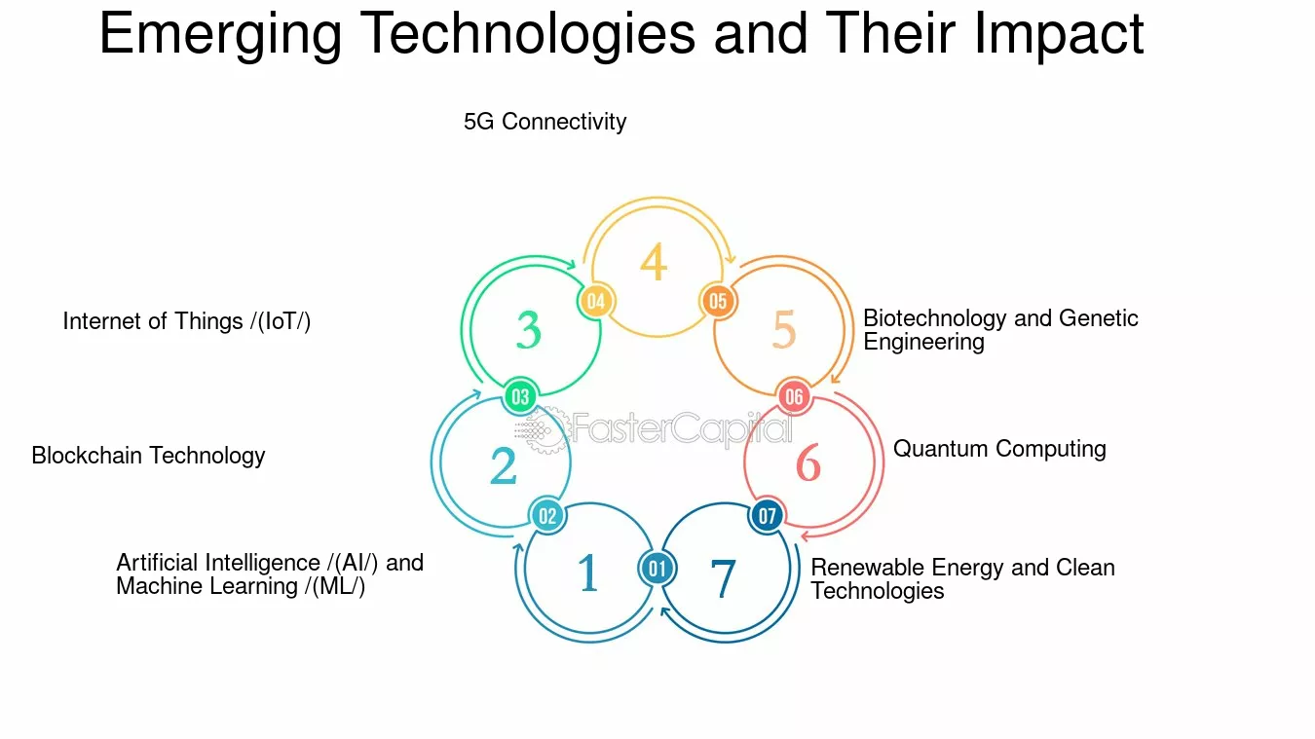
Activity - Investigating Emerging Technologies and Their Impact on Industries
Objective: In your teams, you will investigate the current and potential uses of a range of emerging technologies and analyze their impact on various industries. You will work collaboratively to research, summarize, and present your findings.
Key Technologies Covered:
AI & VI
IoT
Machine Learning
Robotics
Blockchain
Cloud Services
Biometrics
And more...
Outcome:
A collaborative report and presentation detailing how these technologies are shaping the future of work, business, and society.

